Slide 1

Web Workshop Series 1
Topic : Understanding HTML and CSS
with no Prior Programming
By : Khairul Imam

Slide 2

Khairul Imam
Programmer, UI/UX Designer
Khairulimamofficial@gmail.com
0812 – 8126 – 1376
HTML CSS React JS Python Adobe Illustrator Adobe Photoshop Figma 3D Design Data Science

Slide 3
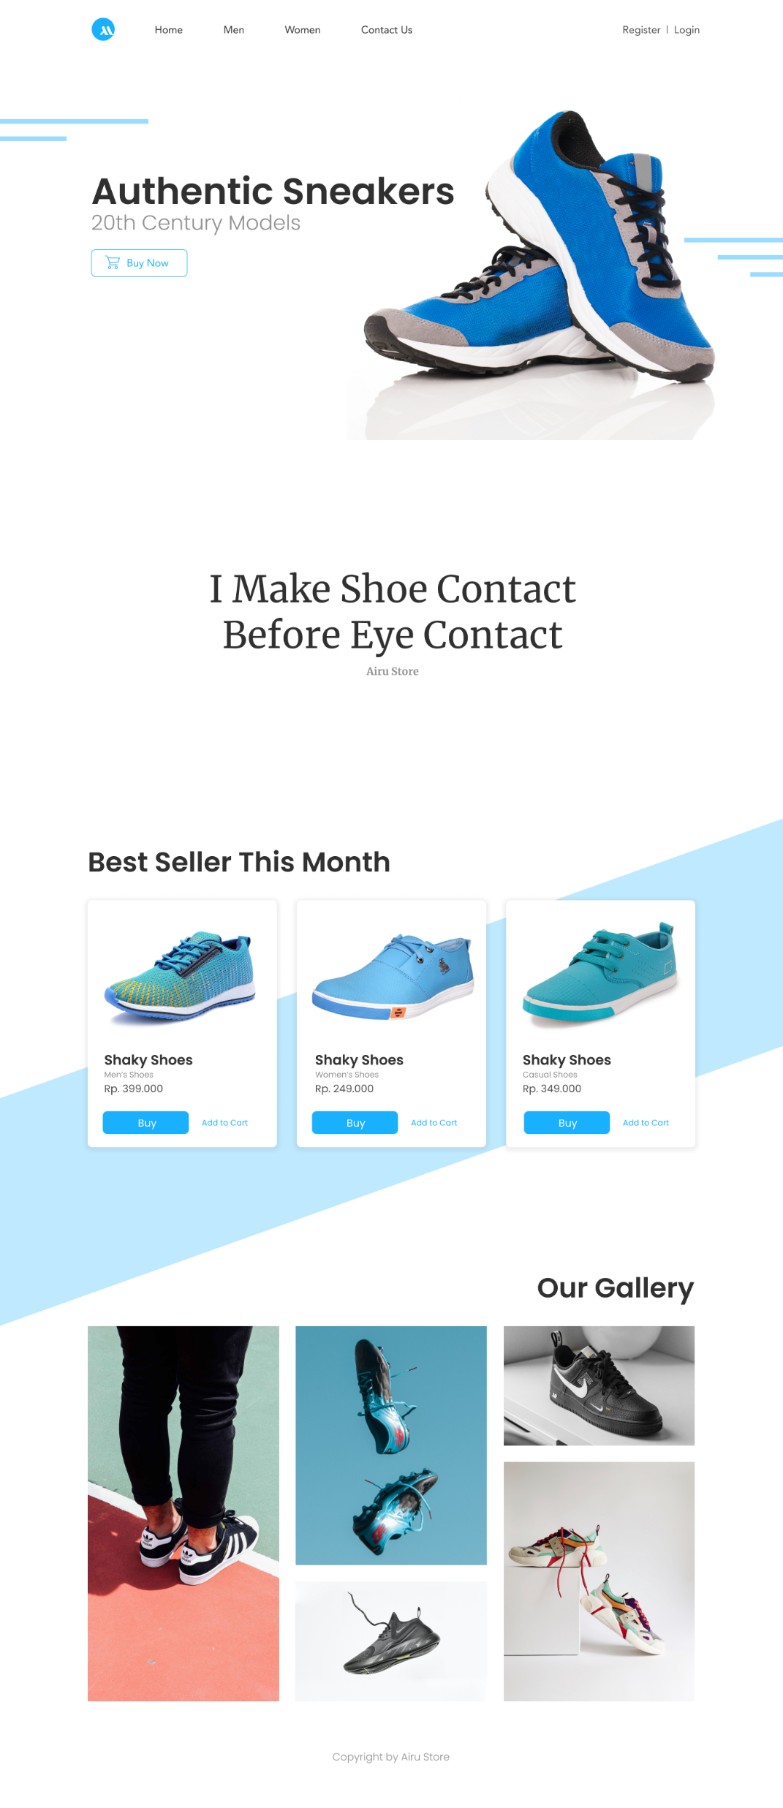

Layout Web
Kepala
Kertas
Figma/Adobe XD

Slide 4

HTML

Slide 5

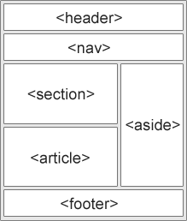
Semantic HTML
A semantic element clearly describes its meaning to both the browser and the developer.
Examples of non-semantic elements: <div> and <span> - Tells nothing about its content.
Examples of semantic elements: <form>, <table>, and <article> - Clearly defines its content.
<article> <aside> <details> <figcaption> <figure> <footer>
<header> <main> <mark> <nav> <section> <summary> <time>

Slide 6
Main root
Text content
<!DOCTYPE html>
<html lang="en">
<head>...</head>
<body>...</body>
</html>
<li> … </li>
represent an item in a list.
<ol> … </ol>
rendered as a numbered list.
<p> … </p>
represents a paragraph.
<ul> … </ul>
as a bulleted list.
Content sectioning
<article> … </article>
self-contained composition in a document,
<aside> … </aside>
represents a portion of a document
<footer> … </footer>
represents a footer
<header> … </header>
element represents introductory content
<h1> to <h6> … </h6>
elements represent six levels of section headings
<main> … </main>
element represents the dominant content
<nav> … </nav>
to provide navigation links
<section> … </section>
element represents a standalone section
Inline text semantics
SYNTAX HTML
<a> … </a>
creates a hyperlink to web
<br>
a line break in text
<code> … </code>
short fragment of computer code
<span> … </span>
generic inline container for phrasing content

Slide 7
Multimedia
Forms
<audio> … </audio>
embed sound content
<img>
embeds an image
<track>
a child of the media elements
<video> … </video>
embeds a media player
<button> … </button>
represents a clickable button
<fieldset> … </fieldset>
used to group several controls
<form> … </form>
submitting information to a web server
<input>
create interactive controls
<label> … </label>
represents a caption
<legend> … </legend>
represents a caption of its parent
<textarea> … </textarea>
multi-line plain-text editing control
Table content
SYNTAX HTML
<table> … </table>
information presented in a two-dimensional
<tbody> … </tbody>
comprise the body of the table
<thead> … </thead>
defining the head of the columns
<tr> … </tr>
defines a row of cells
<td> … </td>
defines a cell

Slide 8

“ Remember that HTML tags must be used for their semantic, not their appearance. It's always possible to totally change the look and feel of a given tag using CSS so, when using HTML, take the time to focus on the meaning rather than the appearance“.

Slide 9

CSS

Slide 10
CSS selectors
define the elements to which a set of CSS rules apply.
https://www.w3schools.com/cssref/css_selectors.asp
Basic selectors
Combinators
* - select All
nav - select by element
.class - select by class
# - select by ID
[att] - select attribute
space - select inside
> - select first children
~ - select sibling in same parent
+ - select after element
Pseudo
Grouping
: - select information (inc. effect)
:: - select custom
, - select both element

Slide 11
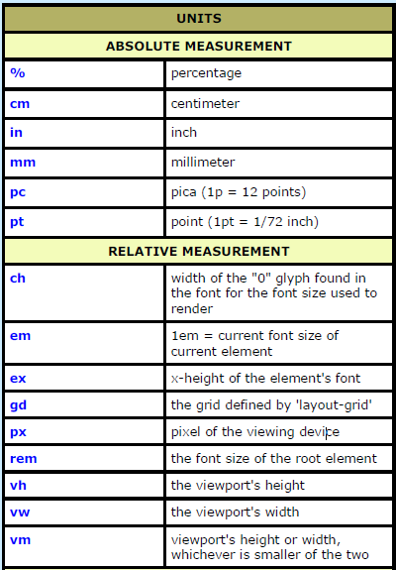
CSS Units
Absolute Lengths
The absolute length units are fixed and a length expressed in any of these will appear as exactly that size.
Relative Lengths
Relative length units specify a length relative to another length property. Relative length units scale better between different rendering medium.

Slide 12
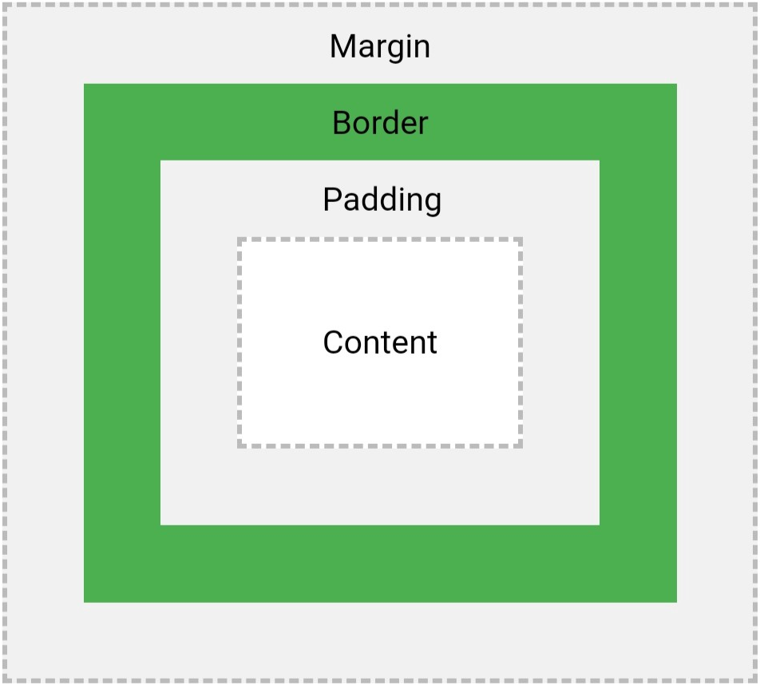

Box Model
div { width: 300px; border: 15px solid green; padding: 50px; margin: 20px; }
div {
margin: 12px 24px; padding: 12px 24px 12px 24px; }

Slide 13
CSS Specificity
Think of specificity as a score/rank that determines which style declarations are ultimately applied to an element.
The specificity of A is 1 (one element)
The specificity of B is 101 (one ID reference and one element)
The specificity of C is 1000 (inline styling)
Since 1 < 101 < 1000, the third rule (C) has a greater level of specificity, and therefore will be applied.
example:
A: h1 B: #content h1 C: <div id="content"><h1 style="color: #ffffff">Heading</h1></div>

Slide 14

Mobile First and Responsive
it helps to save product design time and improve designers’ productivity. On the other hand, it forces designers to pay more attention to the content of a product, which helps them to created neat and practical designs. However, as smartphones become more and more powerful, the mobile end might no longer be considered as “lower ends” in the near future, so the “move first” may not be an everlasting topic.

Slide 15
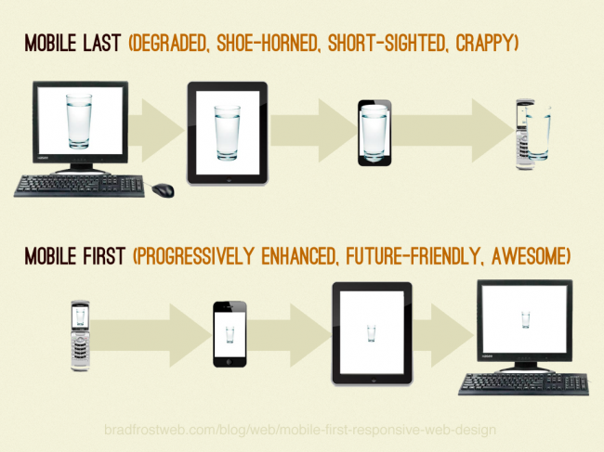
Mobile First
and
Responsive

Slide 16
Media query
It uses the @media rule to include a block of CSS properties only if a certain condition is true.
/* Extra small devices (phones, 600px and down) */ @media only screen and (max-width: 600px) {...} /* Small devices (portrait tablets and large phones, 600px and up) */ @media only screen and (min-width: 600px) {...} /* Medium devices (landscape tablets, 768px and up) */ @media only screen and (min-width: 768px) {...} /* Large devices (laptops/desktops, 992px and up) */ @media only screen and (min-width: 992px) {...} /* Extra large devices (large laptops and desktops, 1200px and up) */ @media only screen and (min-width: 1200px) {...}

Slide 17
Additional Things

Slide 18

Budayakan Menggunakan Komentar
HTML
<!-- Write your comments here -->
CSS
/*-- Write your comments here --*/
Javascript
//-- Write your comments here --//

Slide 19
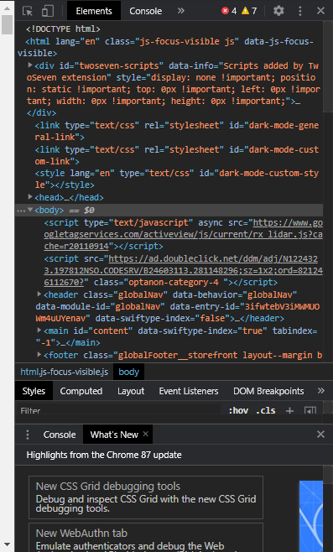
Inspect Element
Tempat Eksperiment
Pengujian Web Responsif

Slide 20
1
1
JPG, PNG, atau SVG?

Slide 21
2
Saya pengen web yang
unik pokoknya

Slide 22
3
Bungkus Membungkus
(Container/wrapper)

Slide 23
4
Penamaan class/id dengan baik

Slide 24
Code is Coming…

